Slide 1
Topic 7: Measuring Electric Power

Slide 2
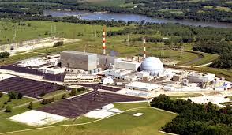
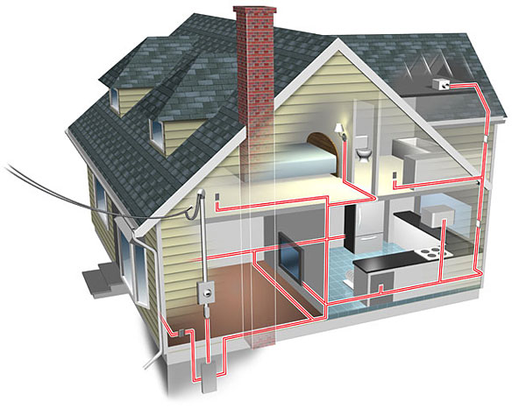
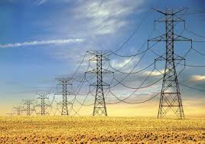
Getting electricity to your home
https://www.youtube.com/watch?v=20Vb6hlLQSg
Power generating station → transmission lines → home
Step- up transformer
Step- down transformer

Slide 3
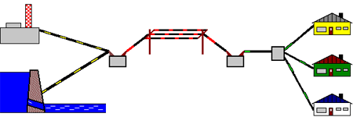
Step up vs Step down
Step up transformer | Step down transformer

Slide 4
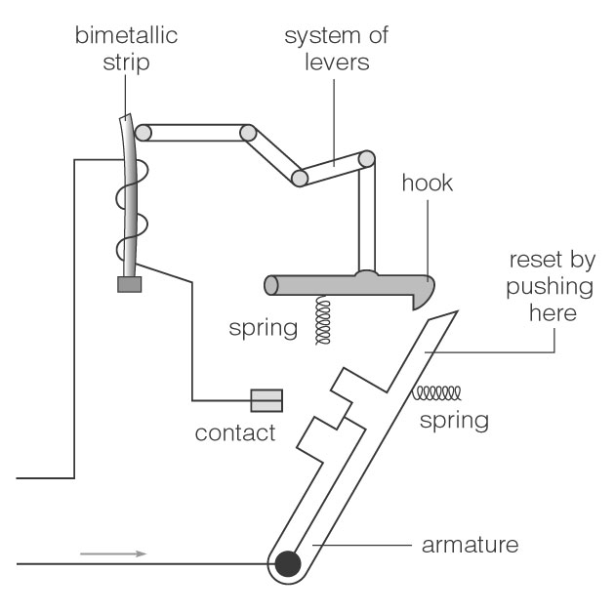
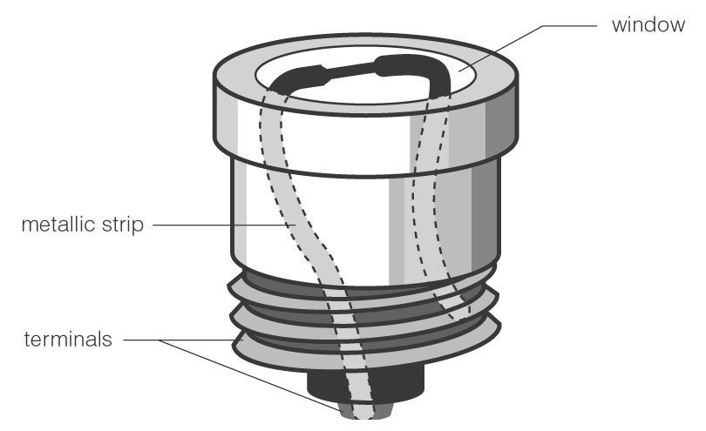
What if there is too much current?
Safety features:
FUSE CIRCUIT BREAKER

Slide 5
Measuring electric power
ELECTRIC POWER is the amount of electric energy that is converted into other forms of energy (heat, light, sound, or motion) every second →the symbol for power is P
-the units that power is measured in is WATTS (W)
Can be measured two ways:
Power (Watts) = Energy (in Joules) P = E Time (in seconds) t
-or-
Power (Watts) = Current (Amps) X Voltage (Volts)
P = I x V

Slide 6
Conversions
*One watt is a small amount of electric power. Usually, watts will be converted into kilowatts (kW) by dividing watts by 1000.
1000W = 1KW
1430 watts = ___________kW
12350 watts = __________kW

Slide 7
Ex. A current of 13.6A passes through an electric heater when it is connected to a 100V wall outlet. What is the power of the heater?

Slide 8
Ex. If the voltage across a device is 100V and the power that the object uses is 1200W, what is the current that is running in the circuit?

Slide 9
Paying for electrical energy
→power companies charges the consumer for the amount of wattage used each hour
→the units that power companies use to measure the electricity is called a Kilowatt hour (kW∙hr)
→the power company charges you for every kW∙h that you use
To calculate:
Cost = Total energy in kWh X Cost in $ per kWh

Slide 10
Cost = Total energy in kWh X Cost in $ per kWh
Ex) A meter reader determines that a business has used 3550 kW•h of energy in two months. If electricity costs 10 cents per kW•h, calculate the bill. Calculations:

Slide 11
Ex. A ceiling fan will use 300W of power to function. If you use the fan for 3 hours a day over a 30 day period, and the cost per kW∙h is 11 cents, how much will it cost you to run the ceiling fan?

Slide 12
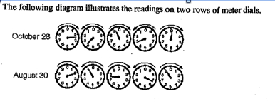
Based on the meter readings above, what is the reading of meter dials on October 28?
Based on the meter readings illustrated above, what is the total consumption of energy between August 30 and October 28?

